Slide 1
UNIT-II
MODEL ERRORS
Regression and Classification errors

Slide 2
Types of Machine Learning Models:
Prediction Models/ Regression Models- target is continuous
Simple Linear Regression
Multiple Linear Regression
Logistic Regression
Ridge Regression
Classification Models- target is discrete, categorical labels
Logistic Regression-Binary classifier
K-Nearest Neighbor Classifier
Decision Tree- Random Forest
Naïve Bayes
Support Vector Machines (SVM)

Slide 3
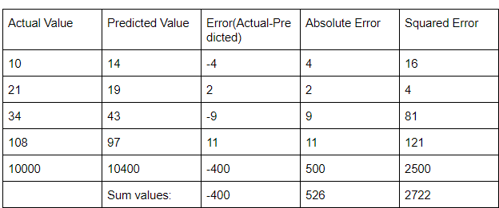
Model Performance Evaluation Metrics:
in regression we check error by measuring the difference in predicted and actual values,
the objective is to minimize the error score in order to improve the model performance.
Table-1

Slide 4
Regression error measuring metrics:
MSE-Mean squared error
RME-Root Mean squared error
MAE-Mean absolute error

Slide 5
Mean Squared Error:
There can be instances where large errors are undesirable. Let’s say that one of the predictions of a model is an outlier. In this case, we should penalize this higher error to a greater extent. Which is where we can use mean squared error.
The average of the sum of squares of differences between the predicted and actual values of the continuous target variable.
MSE = Σ (y_actual – y_predicted)² / n
from table 1 data
MSE will be 544.4

Slide 6
Root Mean Squared Error:
The metric of the attribute changes when we calculate the error using mean squared error. For e.g, if the unit of a distance-based attribute is meters(m) the unit of mean squared error will be m2, which could make calculations confusing. In order to avoid this, we use the root of mean squared error.
RMSE = √MSE = √ Σ (y_actual – y_predicted)² / n
from Table-1 data
RMSE will be 23.33

Slide 7
Mean Absolute Error:
As the name suggests the mean absolute error can be defined as the mean of the sum of absolute differences between the predicted and actual values of the continuous target variable.
MAE = Σ | y_actual – y_predicted | / n
From table 1 data
MAE will be 526/5 = 105.2

Slide 8
Regression model’s performance measuring Metric:
The regression model performance is measured by R² and adjusted R²
R² is the co-efficient of Determination as discussed in simple and multiple regression.
R-squared acts as a benchmark metric for judging a regression model’s performance, irrespective of the range of values the target variable presents.
The range of r-squared is between 0 and 1.
The greater the r-squared value (approaching 1) the better our model’s performance is.
When new features are added to data, the R-squared value either increases or remains the same.
However, adding features does not always guarantee a better performance for the model and r-squared fails to adequately capture the negative impact of adding a feature to our model, i.e whether the feature actually improves model predictions or not.
In order to address this problem, the adjusted r-squared metric is used.

Slide 9
Classification Model Evaluation Metrics:
Classification evaluation metrics score generally indicates how correct we are about our prediction.
The higher the score, the better our model is.
Before diving into the evaluation metrics for classification, it is important to understand the confusion matrix.
Confusion Matrix:
A confusion matrix is a technique for summarizing the performance of a classification algorithm.
A few terms associated with the confusion matrix are
True positive: An instance for which both predicted and actual values are positive.
True negative: An instance for which both predicted and actual values are negative.
False Positive: An instance for which predicted value is positive but actual value is negative.
False Negative: An instance for which predicted value is negative but actual value is positive.

Slide 10
Classifier performance measures:
Recall/sensitivity
Precision
specificity
Accuracy
F1 score

Slide 11
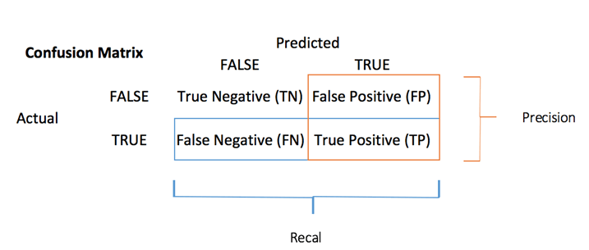
Confusion Matrix:

Slide 12
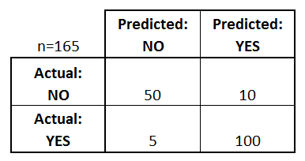
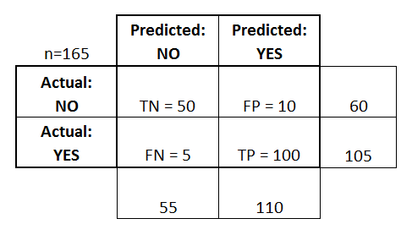
Confusion Matrix: example
Type-I error: FP
Type-II error: FN

Slide 13
Type-1 and Type-2 errors:
Type I Error (False Positive ) (FP)
A type I error occurs when the null hypothesis is true, but is rejected.
A type I error, or false positive, is asserting something as true when it is actually false.
Type II Error (False Negative)(FN)
A type II error occurs when the null hypothesis is false, but erroneously fails to be rejected.
A type II error, or false negative, is where a test result indicates that a condition failed, while it actually was successful.

Slide 14
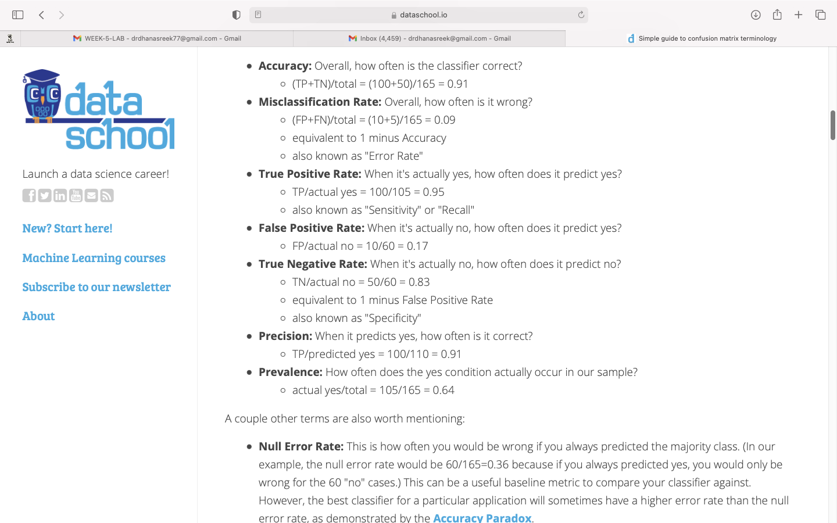

Slide 15
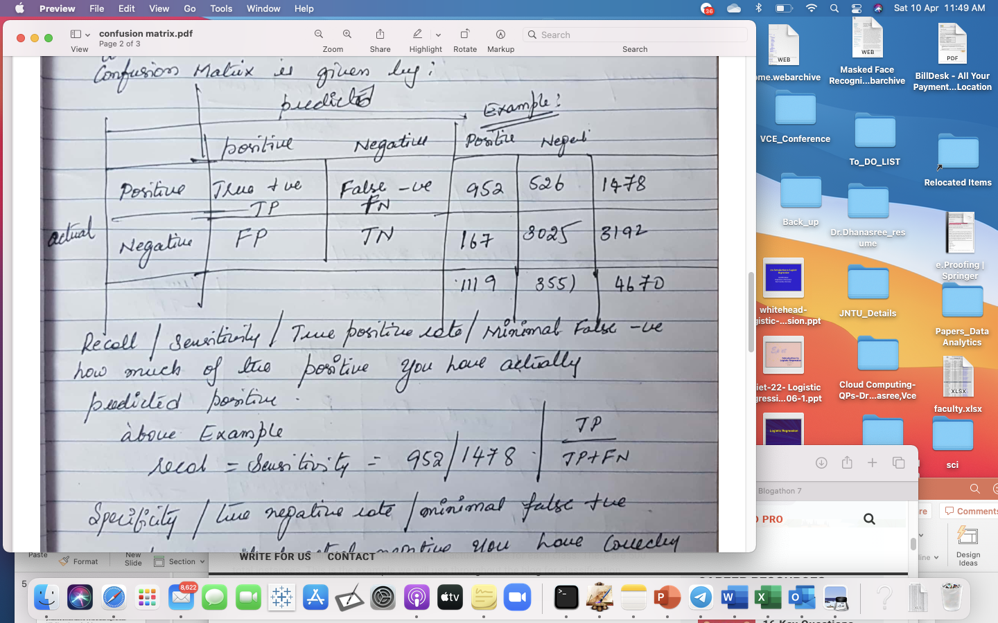
Confusion Matrix: example 2

Slide 16
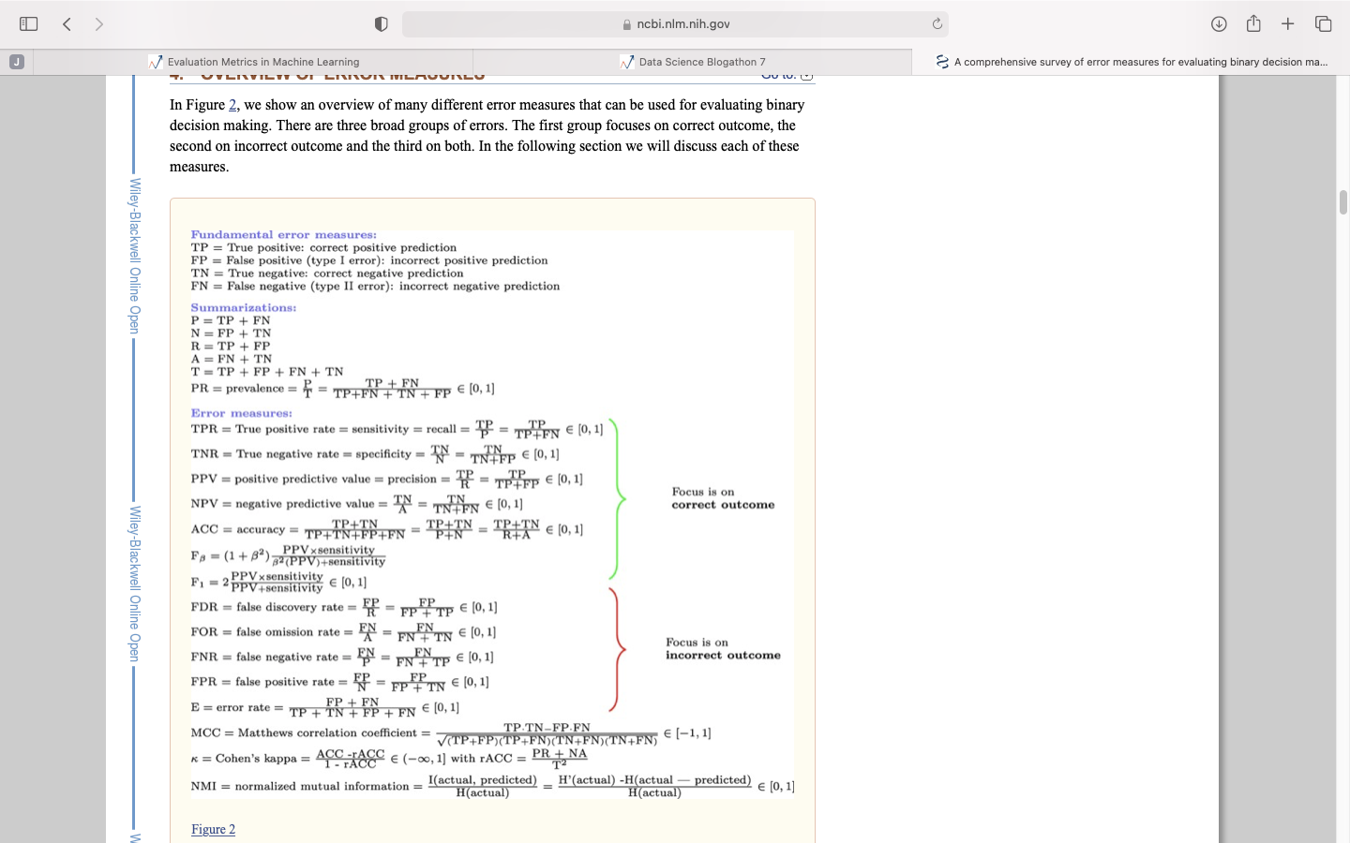
Classifier error metrics:

Slide 17
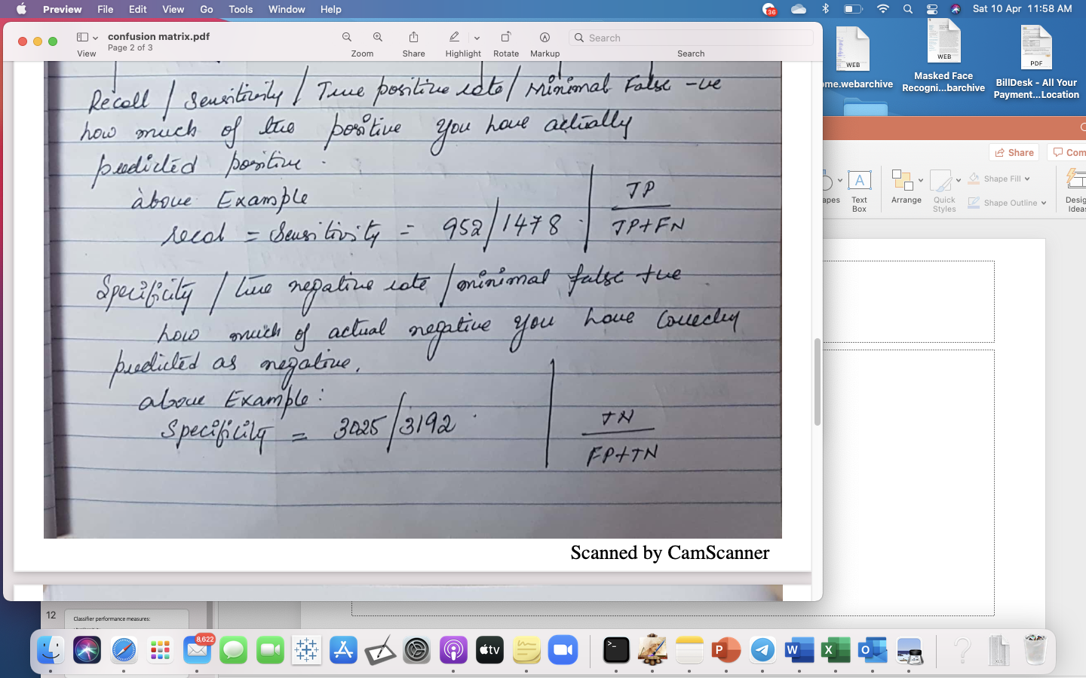

Slide 18
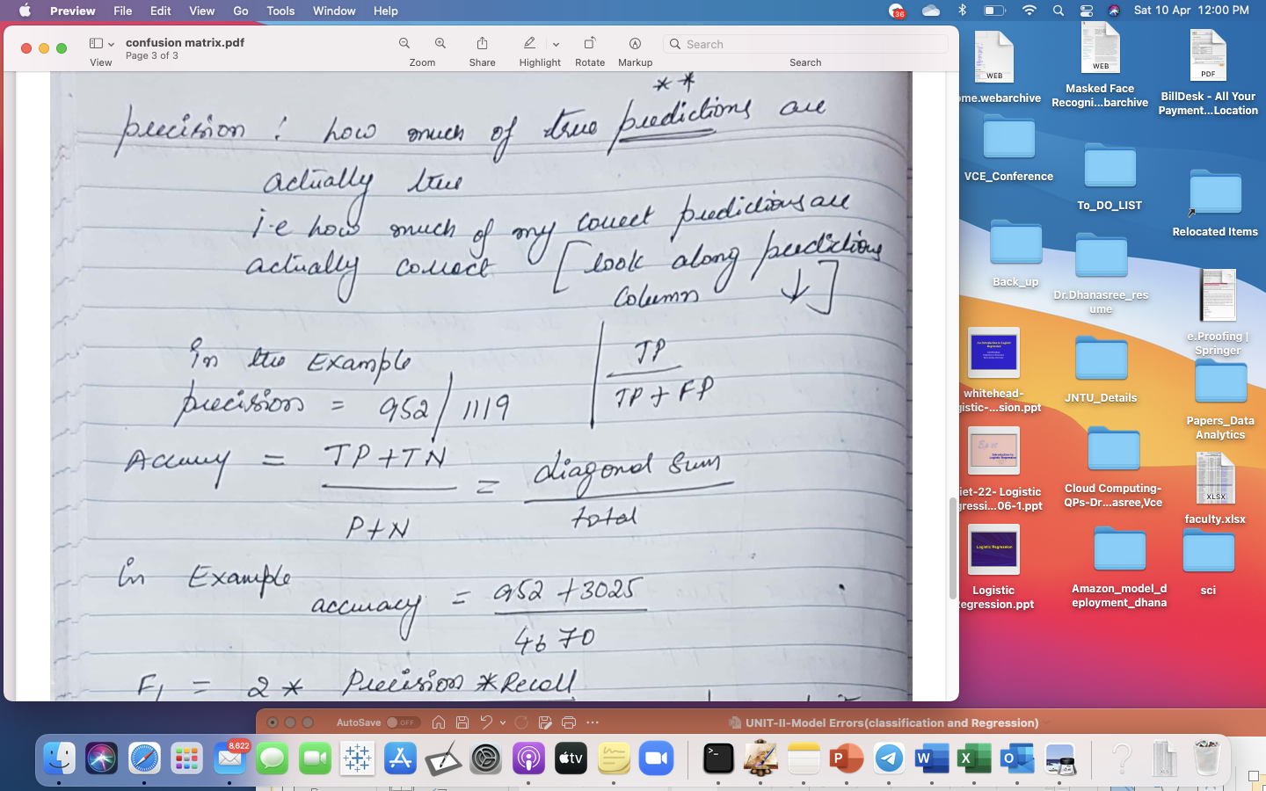

Slide 19
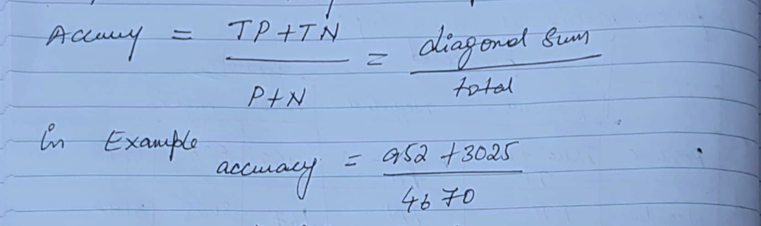
Accuracy:
Accuracy can be defined as the percentage of correct predictions made by our classification model.

Slide 20
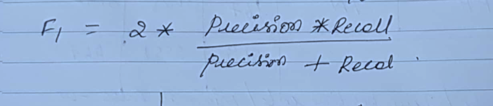
F1 score:
avoiding both false positives and false negatives are equally important for our problem, we need a trade-off between precision and recall.
This is when we use the f1 score as a metric.
An f1 score is defined as the harmonic mean of precision and recall.

Slide 21
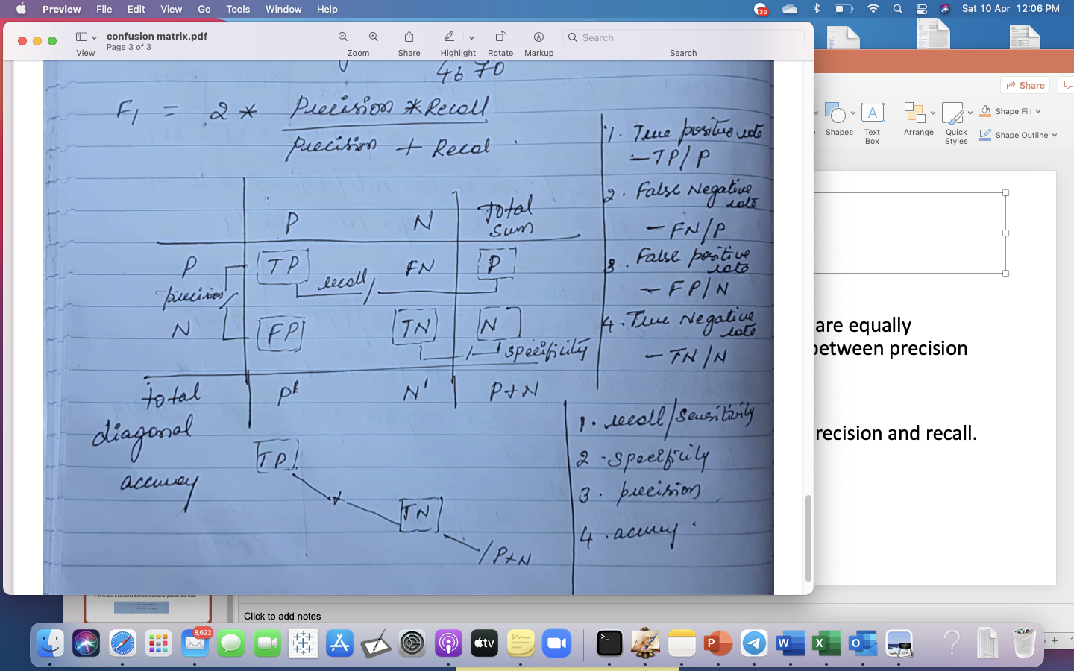
Logic to remember confusion matrix:

Slide 22
Use F1 score to see classifier performance:
The F1 Score combines Precision and Recall into a single measure, which is their product divided by their average.
This is known as the harmonic mean of the two values.
So to study the classifier performance usually F1 score is used.
the higher the F1 score the better, with 0 being the worst possible

